Slide 1
Logistics
Submit peer reviews by 6pm.
Milestone 2: Due Nov 4 (tomorrow)
Describe your progress in no more than 2 pages

Slide 2
Lecture 18 Fairness in AI
Instructor: Chien-Ju (CJ) Ho

Slide 6
Isn’t the point of ML to discriminate?
Want to avoid “unjustified” discrimination

Slide 7

Example: Loan Applications
By law, the banks can’t discriminate people according to their race.
First natural approach (fairness through blindness)
remove the race attribute from the data
Guess what happened?
Redlining

Slide 8
What should we do?
From computer scientists / engineers’ point of view….
Give me an operational definition of fairness, I’ll implement a system that satisfy it!
How should we define fairness?
Is it even possible to define a universal fairness notion?

Slide 9
This Lecture: Group Fairness
Consider social groups defined by sensitive attributes, such as gender, race, sexual orientation, etc.
If we believe a decision shouldn’t be depending on these sensitive attributes, then we want the outcome for different groups to be similar.

Slide 10
Probation Decisions
COMPAS
A ML classifier to predict whether the prisoner will commit a crime after probation.

Slide 11
Controversy and Debates
ProPublica (a non-profit institution)
COMPAS is not fair!

Slide 12
Controversy and Debates
Northpointe (company that develops COMPAS)
COMPAS is fair!

Slide 13
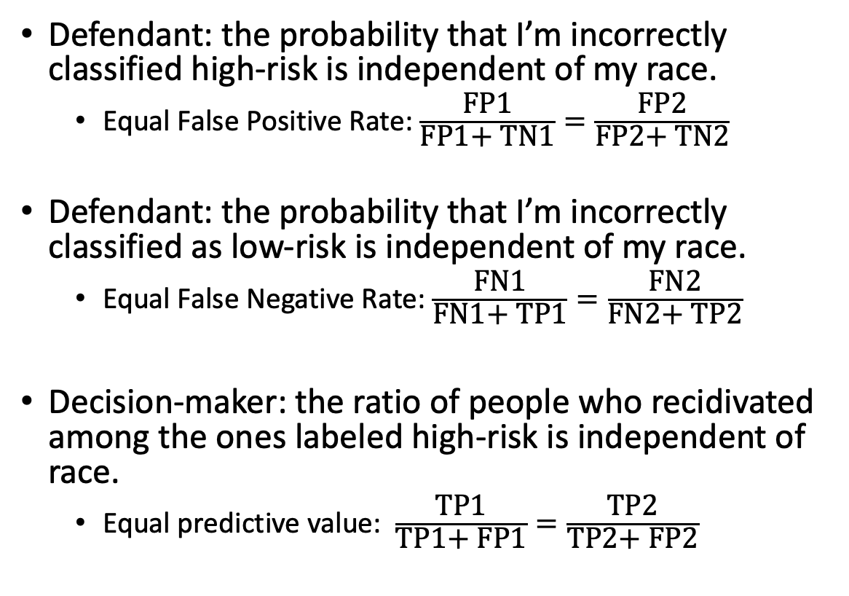
Won’t
Recidivate
TN1 | FP1
FN1 | TP1
Defendant: the probability that I’m incorrectly classified high-risk is independent of my race.
Equal False Positive Rate: $\frac{\text{F}\text{P}\text{1}}{\text{F}\text{P}\text{1+ }\text{TN}\text{1}}=\frac{\text{F}\text{P}\text{2}}{\text{FP}\text{2+ }\text{TN}\text{2}}$
Defendant: the probability that I’m incorrectly classified as low-risk is independent of my race.
Equal False Negative Rate: $\frac{\text{FN}\text{1}}{\text{FN}\text{1+ }\text{TP}\text{1}}=\frac{\text{FN}\text{2}}{\text{FN}\text{2+ }\text{T}\text{P}\text{2}}$
Decision-maker: the ratio of people who recidivated among the ones labeled high-risk is independent of race.
Equal predictive value: $\frac{\text{TP}\text{1}}{\text{TP}\text{1+ }\text{FP}\text{1}}=\frac{\text{TP}\text{2}}{\text{TP}\text{2}\text{+ }\text{F}\text{P}\text{2}}$
Will
Recidivate
Labeled Low-Risk
Labeled High-Risk
Won’t
Recidivate
TN2 | FP2
FN2 | TP2
Will
Recidivate
Labeled Low-Risk
Labeled High-Risk
Impossibility Result [Kleignberg et al. 2016]
The above three conditions cannot be satisfied simultaneously, unless the predictor is perfect or the two groups are the same.

Slide 14
There are more definitions of fairness
If there are intrinsic differences between the groups, is it fair to ignore them?
Another setup
A: Sensitive attributes (e.g., race)
Y: True labels (e.g., commit a crime in the future)
C: Predictions (e.g., predictions of recidivism)
Criteria:
C independent of A
C independent of A conditional on Y
Y independent of A conditional on C
The same impossibility results exist!

Slide 15
There are more possible definitions of fairness
FAT*18 Tutorial: 21 Definitions of Fairness and Their Politics. Arvind Narayanan.

Slide 16
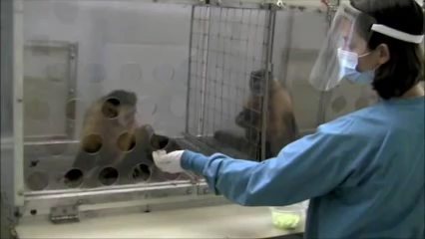
Individual Fairness
Cucumbers and Grapes: https://youtu.be/-KSryJXDpZo

Slide 17
Individual Fairness
Similar people should be treated similarly
Challenges
What do we mean by similar people
Need to define some kind of “distance” measure
What do we mean by being treated similarly
Decisions based on threshold won’t work
Need to impose some “smooth” notion
Randomization is often required

Slide 18
Counterfactual Fairness
A decision is fair towards an individual if it gives the same predictions in
(a) the observed world and
(b) a world where the individual had always belonged to a different demographic group

Slide 19
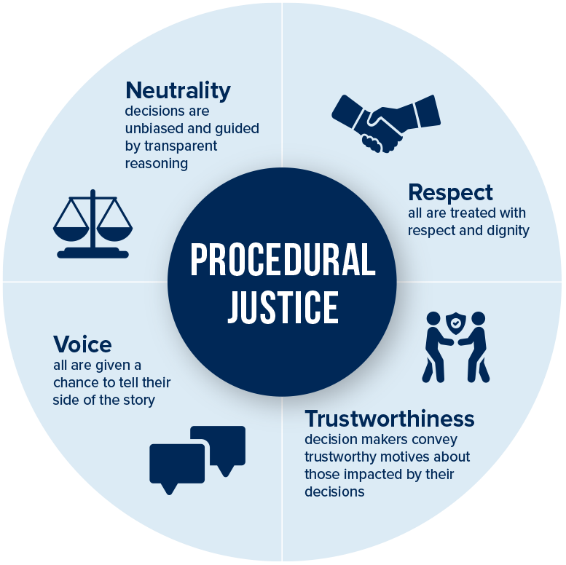
Procedural Fairness (Procedural Justice)

Slide 20
Representation

Slide 21
Take-Aways
As AI/ML becomes more ubiquitous in our daily decision making, ethical issues are getting more important as well.
Being aware of the issues is the important first step!
”Solving” the issues (if at all possible) requires communications among people in different disciplinaries.
More references:
NIPS17 Tutorial: https://vimeo.com/248490141
FAT*18 Tutorial: https://www.youtube.com/watch?v=jIXIuYdnyyk
FAT*19 Putting fairness in practice: https://algorithmicbiasinpractice.wordpress.com

